Slide 1

Records Management Policy and Process Training
Quality Management System Team
Notes:
Welcome to the Records Management Policy and Process Training from the Quality Management System Team. In this module, we’ll walk through the basics of how records should be identified, organized, stored, retrieved, and properly disposed of. The goal is to make records management practical, clear, and easy to apply in day-to-day work.

Slide 2

Reminders
Learning ID PLAN-47B0DC7C6874
Required to complete all sections below to earn Think 40 credits :
  Section 1: Records Management Policy Training
  Section 2: Records Management Process Training
  Section 3: Assessment (target passing rate: 85%)
Notes:
Before we begin, here are a few reminders. Section 1 of this training, which covers the Records Management Policy, is required. Sections 2 and 3 are also required, and there is an assessment at the end with a passing score of 85 percent. As you go through the material, take note of the key roles, tools, and requirements that support compliance.

Slide 3
Training Objectives
1
Gain understanding on IBM records classification, storage, retrieval and disposal policies.
2
Learn about the roles and responsibilities in managing records.
3
Familiarize with the records management tools and templates.
Notes:
By the end of this training, you should be able to do three things. First, understand IBM’s policies for records classification, storage, retrieval, and disposal. Second, know the roles and responsibilities of employees involved in managing records. And third, become familiar with the tools and templates used for records management.

Slide 4




Records Management Objectives
Ensure that records are identified and classified accordingly.
Ensure that records are stored in appropriate media and storage facilities.
Ensure that records are retrievable.
Ensure the timely disposal of obsolete records.
Notes:
Records management has four main objectives. We want to make sure records are correctly identified and classified, stored using suitable media and storage facilities, and easy to retrieve when needed. Just as importantly, we must ensure obsolete records are disposed of on time. In short, good records management helps keep information secure, accessible, and compliant throughout its lifecycle.

Slide 5
Records Management Process Flowchart
Users can update issue statuses at any time, giving stakeholders a real‑time view of all issues.
Users can update issue statuses at any time, giving stakeholders a real‑time view of all issues.
Records Management Process Flowchart
Onsite/Offsite Archiving
GRE Team
Records
Retention Requirements
(Contractual Agreement)
Client/CSM/
Operations Manager
Records Owner
(HR Delivery Manager/Operations Leads)
1. Identification and Classification of Records
Start
2. Organizing, Labeling and Indexing of Records
3. Storage of Records
4. Retrieval of Records
5. Disposal of Records
Records Custodian
(HR Process Owners/Team Leads)
End
Notes:
This slide shows the overall records management process flow, from identification and classification all the way to disposal. Two key roles drive this process: the Records Owner and the Records Custodian. Supporting roles also play an important part. The Client or Operations Manager provides direction on records retention requirements based on contractual agreements, while the GRE Team supports offsite archiving needs. As we move forward, we’ll look more closely at how each step works and who is responsible for it.

Slide 6

Roles and Responsibilities
Notes:
Now let’s focus on roles and responsibilities. Records management works best when each role is clear and consistently carried out. In the next few slides and knowledge checks, you’ll see how the Records Owner and Records Custodian contribute to the overall process and why both roles are important to effective records governance.

Slide 7

Records Owner
- Identification and classification of Records
Users can update issue statuses at any time, giving stakeholders a real‑time view of all issues.
Users can update issue statuses at any time, giving stakeholders a real‑time view of all issues.
It is the responsibility of the Records Owner to identify which records are to be retained. This may be based on how records are classified in accordance with IBM or Client Requirements.
Classification of records should also be considered in accordance with IBM policies (WRM), for IBM or Client owned records.
Identification of Records to be retained and their classification should be reflected in each respective Records Matrix.
Notes:
The Records Owner is responsible for determining which records need to be retained. This decision should follow IBM policies, including WRM, and may also depend on client requirements for either IBM-owned or client-owned records. Once identified, these records and their classifications should be documented in the appropriate Records Matrix.

Slide 8
Records Custodian
- Identification of storage location
It is the responsibility of Records Custodian select a location, media type and format that is appropriate to the records being retained. This should include arrangements as to how they will be protected and eventually retrieved.
Type of Storage
Onsite
Offsite
Physical
Electronic
Physical
Lateral Cabinets
Lockers
Mobile pedestals
Boxes
Database or Tools like Cobee Lite.
Offsite Storage and Archiving should be coordinated with GRE Team.
Characteristics
Documents should have labels including actual filenames, record series codes, and retention dates.
Document labels should be included in the report extracted from the tool.
Offsite Storage should be coordinated with the GRE Team.
Notes:
The Records Custodian is responsible for selecting the right storage location, media type, and format based on the nature of the records. For onsite physical records, this may include lateral cabinets, lockers, mobile pedestals, or boxes. For electronic records, storage may be in databases or tools such as Cobee Lite. Documents should be clearly labeled with filenames, record series codes, and retention dates. If offsite storage or archiving is needed, coordination should be done with the GRE Team and the accredited vendor.

Slide 9
Records Custodian
- Organization of records
It is the responsibility of Records Custodian to organize the records in the manner that will allow them to identify and retrieve records effectively and efficiently.
A label is considered accurate if it has the following basic information:
Record Code
Filename
Coverage Date
Computed end of retention period
Data Classification
Notes:
Organizing, labeling, and indexing are essential for efficient records management. The Records Custodian is responsible for arranging records in a way that makes them easy to identify and retrieve. An accurate label should include the record code, filename, coverage date, computed end of retention period, and data classification. When these details are complete and consistent, finding the right record becomes much faster and more reliable.

Slide 10
Labeling of Records
Notes:
Now let’s turn our attention to records labeling. Proper labeling helps ensure records are organized, retained, and managed consistently throughout their lifecycle.

Slide 11
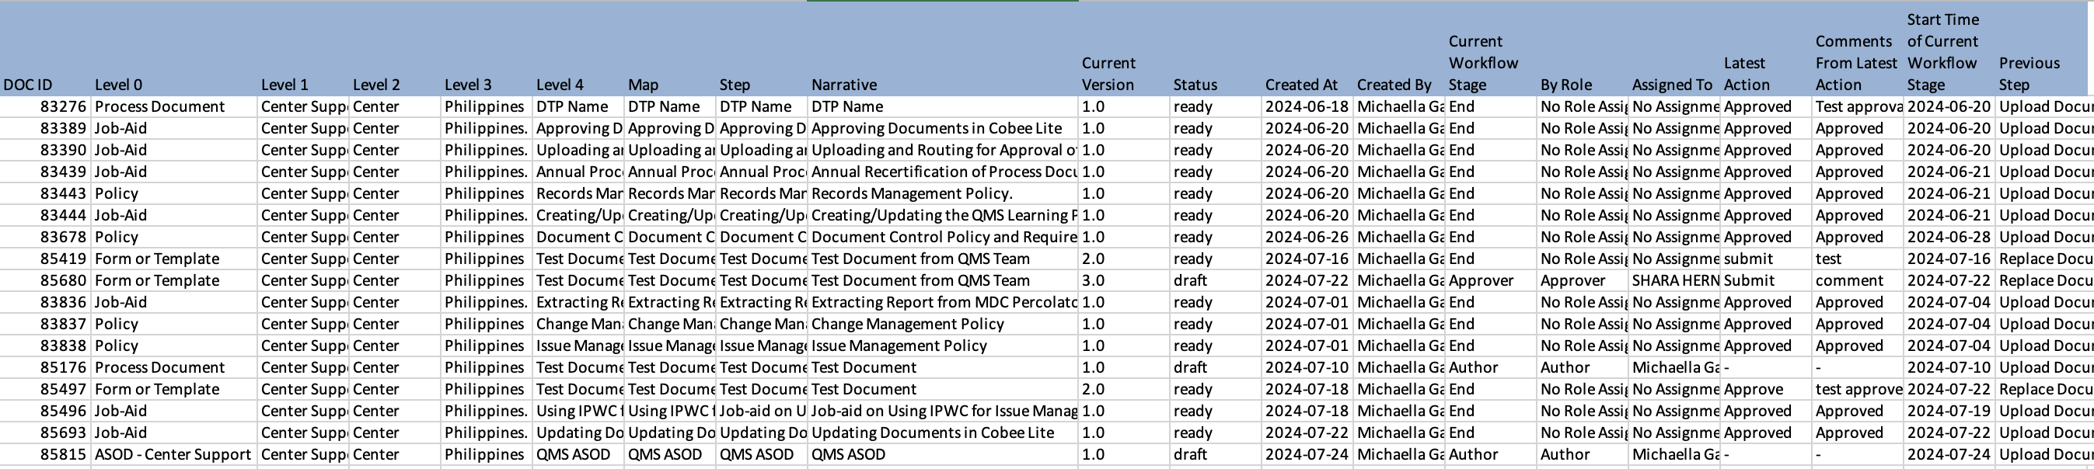
Electronic Records Labeling
For electronic records stored report extract should include the necessary Information about the documents.
Document Name/Title
Unique identifier ex. document number
See Appendix section for guidance on labeling hard-copy documents
Notes:
For electronic records stored online, such as in Cobee Lite, the extracted report contains the necessary document information. This supports visibility, tracking, and easier validation of record details. In other words, the tool helps ensure that electronic records are not only stored properly, but also documented in a way that supports retrieval and compliance.

Slide 12
Records Retrieval and Disposal
Notes:
With records properly labeled, the next step is understanding records retrieval and disposal. These processes help ensure records remain accessible when needed and are handled appropriately throughout their lifecycle.

Slide 13

Retrieval of Records
Records are to be made easily accessible and readily retrievable by all who need them, whether they may be from onsite or offsite storage facility.
Onsite
Electronic
The electronic system can recover the information in a readable format for the duration of the retention period.
Physical
Cabinets , laterals, lockers, boxes should easily be identified using indexing and labeling.
Off-site
Retrieval request shall be forwarded to GRE Team to retrieve these records from the vendor.
Notes:
Retrieval of records should be straightforward whether the records are stored onsite or offsite. For physical records onsite, cabinets, lockers, laterals, and boxes should be clearly indexed and labeled so items can be located quickly. For electronic records, the system should be able to recover information in a readable format for the full retention period. If records are stored offsite, retrieval requests should be coordinated through the GRE Team. The key principle is simple: records must be accessible and readily retrievable by authorized users who need them.

Slide 14
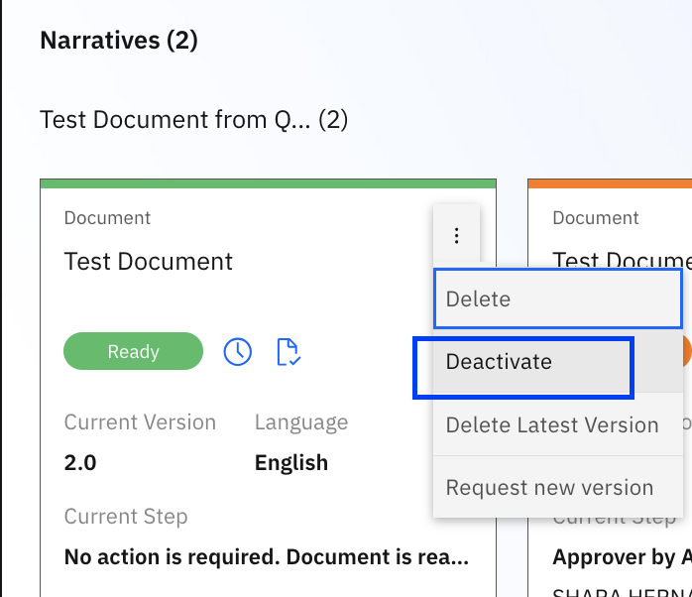

Disposal of Records
Request for obsoletion should be requested via Cobee Lite.
Client owned records should be disposed according to their instructions.
Notes:
When records are no longer needed and have reached the end of their retention period, they should be disposed of properly. Requests for obsoletion should be submitted through Cobee Lite. For client-owned records, disposal must follow the client’s instructions. Proper disposal is just as important as proper storage, because it helps reduce risk and ensures compliance with retention requirements.

Slide 15
Records Matrix
Notes:
Next, we’ll look at the Records Matrix and the process behind its creation. Understanding how records are categorized and assigned retention requirements is key to maintaining a structured and compliant records management program.

Slide 16
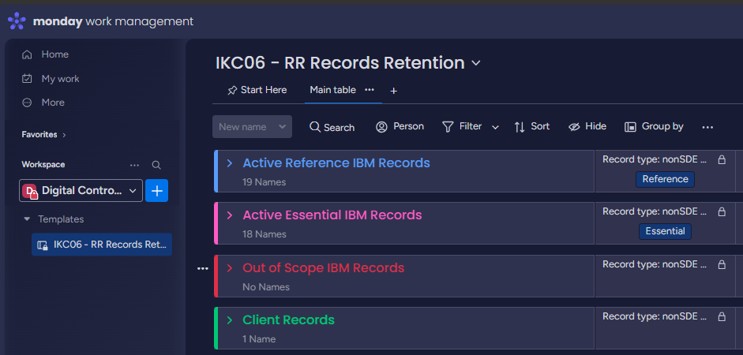
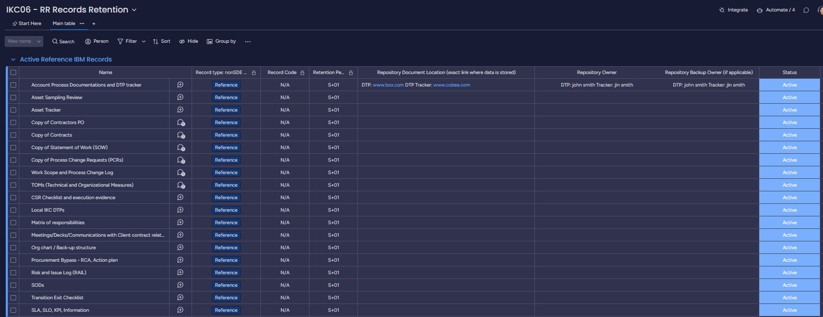
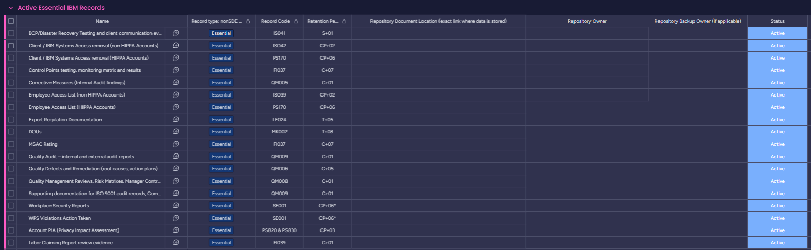
Records Matrix
Notes:
The Records Matrix is a key tool in records management, and serves as the central reference for identifying records, their classifications, and their retention requirements.
Effective June 17, 2026, Records Matrices have been moved from Cobee Lite to monday.com, in the Digital Controls Center – Records Retention board in monday.com and managed by the Business Controls Team.
When filling-out the records matrix, ensure to complete all required repository and ownership details, maintain document statuses accurately, follow the prescribed access levels, and do not modify standardized fields.
Keeping this matrix updated is a foundational part of maintaining good records governance.

Slide 17
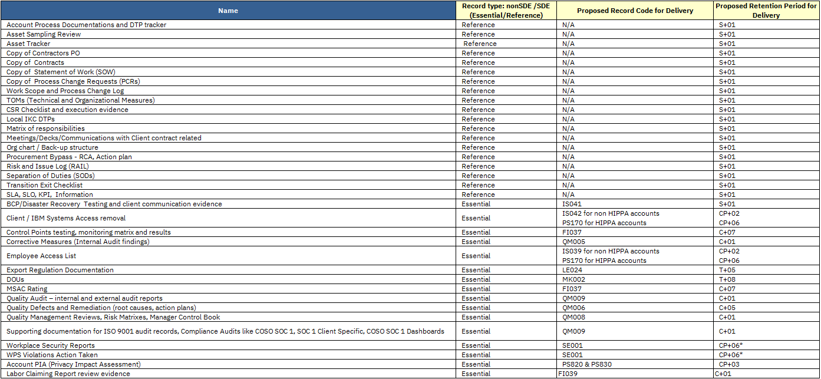
Records Codes and Retention Periods
Records listed below should be included in the Records Matrix.
As per DG 101, any reference materials will not have a record code,
hence NA is assigned to these types of records, which are used by the team in their daily work.
If there are center generated records not listed in the table, please coordinate with your respective Account Business Controls for guidance or visit WRM via this link:
https://w3.ibm.com/w3publisher/data-governance-standards/enterprise-data-governance#WRM_Essential_information_categories
Notes:
Records that apply to your team or process should be included in the Records Matrix. If you have center-generated records that are not listed in the reference table, coordinate with your Account Business Controls for guidance or consult WRM using the link provided.
Visit the same link to learn more about specific records retention periods and how to apply them.
The important takeaway is that the Records Matrix should be complete, relevant, and aligned with both operational needs and policy requirements.

Slide 18
Records Matrix Approvers
ROLE | TOWER
 | TO | F&PO | SHARED SERVICES | CENTER SUPPORT | OTHER TOWERS
APPROVERS | HR Delivery Manager | Team Lead and/or Operations Lead | Team Lead and/or Operations Lead | Team Lead and/or Manager | Team Lead
 | CSM | Operations Manager | Domain Lead (or its equivalent/delegate) | Manager/ Center Leader (or its equivalent/delegate) | Operations Manager (or its equivalent/delegate)
Notes:
This slide outlines the approvers for the Records Matrix across different towers. Depending on the tower, approvers may include HR Delivery Managers, Team Leads, Operations Leads, Domain Leads, Managers, Center Leaders, or Client Service Managers. The approval structure may vary, but the purpose remains the same: to ensure the Records Matrix is reviewed by the right stakeholders and formally approved.

Slide 19

Key Takeaway
Records Matrices are reviewed and approved Annually.
  Ensure listing is complete & information are accurate
Records Retention applies to both hardcopies and electronic copies.
DCC is the new Center’s Records Management Repository.
Remember, that ALL records are auditable.
Changes in the records matrix should be reflected timely.
DTPs and Job Aids are reference records.
  Retention is S+01
Notes:
Here are a few key notes to remember. Cobee Lite is the Center’s Records Management Repository. Records Matrices must be reviewed and approved annually, and the information in them should be complete and accurate. Retention requirements apply to both hardcopy and electronic records. DTPs and Job Aids are considered reference records and should be included in the matrix, with a retention period of S plus 1. Common defects include missing center-generated records, late annual reviews, or having no Records Matrix at all. And one final reminder: all records are auditable.

Slide 20
Knowledge
Check
Notes:
We’ve now reached the knowledge check section. This is a quick way to reinforce the key concepts covered so far. Take a moment to review each question and think through your answer before looking at the explanation.

Slide 21


Question 1
Which of the following is the role and responsibility of a Records Owner?
d.
Assign Records SPOC (Records Custodian) for the team
Archive Listing and Disposal Authorization
Identify records to be retained
All of the above
The answer is all the above. Typically assigned to HR Delivery Manager/Operations Leads (or its equivalent), Records Owner has the responsibility to identify all records to be retained in accordance with IBM/client requirements, assign the Records Custodian for the team, and provide review and approval of the Records Matrix and disposal of records.
Notes:
Let’s begin with Question 1.
Which of the following is the role and responsibility of a Records Owner?
Your options are:
A. Assign Records SPOC, or Records Custodian, for the team
B. Archive listing and disposal authorization
C. Identify records to be retained
Or D. All of the above
The correct answer is D. All of the above.
The Records Owner is responsible for identifying which records must be retained, assigning the Records Custodian for the team, and reviewing and approving both the Records Matrix and the disposal of records. This role is typically assigned to the HR Delivery Manager, Operations Leads, or their equivalent.

Slide 22
Question 2
Which of the following is true when we are talking about the roles and responsibility of a Records Custodian?
b.
Responsible for aiding on communicating request to offsite/archiving vendors to support archiving activities of Records Owner.
Does most of the legwork
Identify, classify and maintains records
None of the above
The answer is: b, does most of the legwork.
Typically assigned to HR Process Owners/Team Leads (or its equivalent), the Records Custodian is primarily responsible for organizing, labeling/indexing, storage, retrieval, and disposal of records. The Records Custodian may also be assigned to maintain the Records Matrix.
Notes:
Now for Question 2.
Which of the following is true when we are talking about the roles and responsibilities of a Records Custodian?
Your options are:
A. Responsible for aiding in communicating requests to offsite or archiving vendors to support archiving activities of the Records Owner
B. Does most of the legwork
C. Identify, classify, and maintain records
Or D. None of the above
The correct answer is B. Does most of the legwork.
The Records Custodian is typically responsible for the day-to-day execution of records management activities. This includes organizing, labeling, indexing, storing, retrieving, and disposing of records. In some cases, the Records Custodian may also maintain the Records Matrix. This role is usually assigned to HR Process Owners, Team Leads, or their equivalent.

Slide 23
Question 3
Which of the following shows the contents of an accurate label?
a.
Record code – Filename – Coverage date – Computed end of retention periods – Data Classification
Record code – Filename – Computed end of retention periods – Data Classification
The answer is A: Record code – Filename – Coverage date – Computed end of retention periods – Data Classification
A label is considered accurate if it has these basic information.
Notes:
Let’s continue with Question 3.
Which of the following shows the contents of an accurate label?
Option A is:
Record code, filename, coverage date, computed end of retention period, and data classification.
Option B is:
Record code, filename, computed end of retention period, and data classification.
The correct answer is A.
An accurate label should contain all five required details: the record code, filename, coverage date, computed end of retention period, and data classification. Including all of these elements helps ensure records can be identified and retrieved correctly and efficiently.

Slide 24
Question 4
What is the meaning of the retention code S+01?
c.
The answer is C. Superseded + 1 year
This means that only the newest version of the record is essential; any previous versions are considered disposable.
This is the retention code assigned to process documents and job-aids, which are required to be reviewed within 365 days from its last approval date.
Special for 1 year
Suspend + 1 year
Superseded + 1 year
None of the above
Notes:
Here is Question 4.
What is the meaning of the retention code Superseded plus 1?
Your options are:
A. Special for 1 year
B. Suspend plus 1 year
C. Superseded plus 1 year
Or D. None of the above
The correct answer is C. Superseded + 1 year
This means that only the newest version of the record is essential; any previous versions are considered disposable.
This is the retention code assigned to process documents and job-aids, which are required to be reviewed within 365 days from its last approval date.

Slide 25
Question 5
You should only review and update your Records Matrix every March.
False.
While Records Matrices have an annual review requirement every March, you may edit/update your Records Matrix in Cobee Lite anytime as needed.
True or False?
Notes:
And now, Question 5.
You should only review and update your Records Matrix every March. True or False?
The correct answer is False.
While Records Matrices do have an annual review requirement, they may be reviewed and updated at any time as needed. If there are changes to your records, processes, or retention requirements, it is best to update the matrix promptly instead of waiting for the annual review cycle.

Slide 26
Appendix
Notes:
The next slides contain additional information and useful references that can help reinforce key records management requirements and processes.

Slide 27
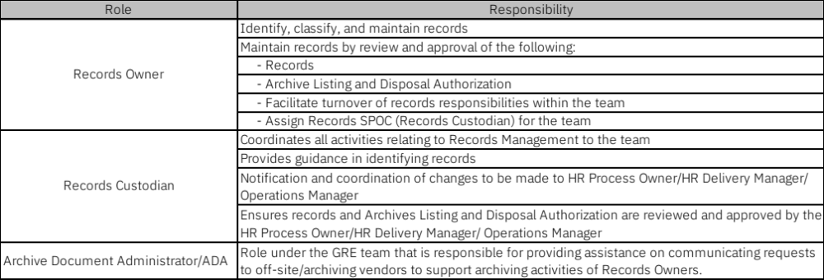
Roles and Responsibilities - Summary
Notes:
Review the key roles and responsibilities and how they work together to support effective records management.

Slide 28
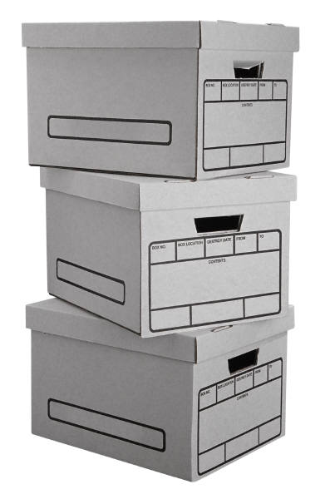

Box Label
PNG-PH-TEA-07001-0117
Arrange files in alphabetical order; files will be listed the same order as they are arranged in the box.
Notes:
Here is an example of a box label for physical records. Labels should be clear, complete, and easy to read. Files should also be arranged in alphabetical order, and the listing should match the same order used inside the box. This simple practice helps save time during retrieval and reduces the risk of misplaced documents.

Slide 29
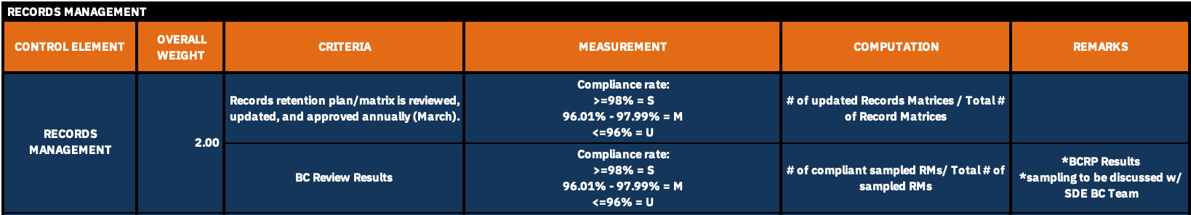
Additional Information
Integrated Operations Publisher Page
https://w3.ibm.com/w3publisher/integrated-operations-publisher
Notes:
For additional information, you may visit the Integrated Operations Publisher page. This site contains more details on QMS tools, policies, training materials, and SOC 1 references. It’s also helpful to know that the annual review and approval of Records Matrices are monitored by the Business Controls Team under the RISC Management Scorecard reported to Center Leadership. In other words, keeping your Records Matrix current is not just a good practice, it is also actively monitored.

Slide 30

End of Training.
Send all questions to cic.ph.delivery.operations@ibm.com
Internal only—Do not distribute outside of
IBM Consulting FutureNow Philippines.
Any hard copy versions of this document are for REFERENCE ONLY. Users of this document are personally responsible for using official version, and for verifying that any copies are complete and of the official version.
Thank you.
Notes:
This brings us to the end of the training. If you have questions, you may send them to the email address shown on the slide. Please remember that this material is for internal use only. Also, any printed copy is for reference only, so always make sure you are using the official and complete version. Thank you for completing the training.

